Slide 1

Fake News Detection Using NLP Classifiers
Submitted By: Akshaya K P
Anusree S

Slide 2



The Global Misinformation Challenge
Social & Political Impact
•
Erosion of Trust: Misinformation undermines public confidence in institutions and media.
•
Electoral Integrity: Manipulative content can sway voter behavior and polarize communities.
•
Information Overload: The sheer volume of digital content makes manual fact-checking unscalable.
•
Rapid Dissemination: Falsehoods often spread faster than corrections across social networks.

Slide 3
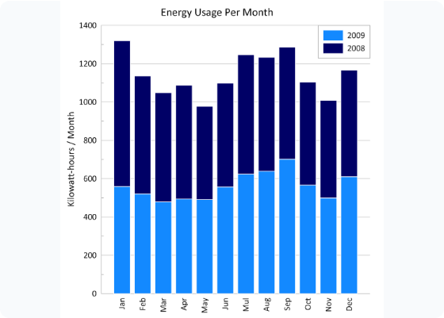
Dataset: The LIAR Corpus
Core Characteristics
The LIAR dataset consists of 12.8k human-labeled short political statements from PolitiFact.com.
Attribute | Description
Labels | 6-way (True to Pants-on-Fire)
Content | Short political claims/statements
Metadata | Speaker, Party, Context, Job
History | Speaker's past veracity counts

Slide 4
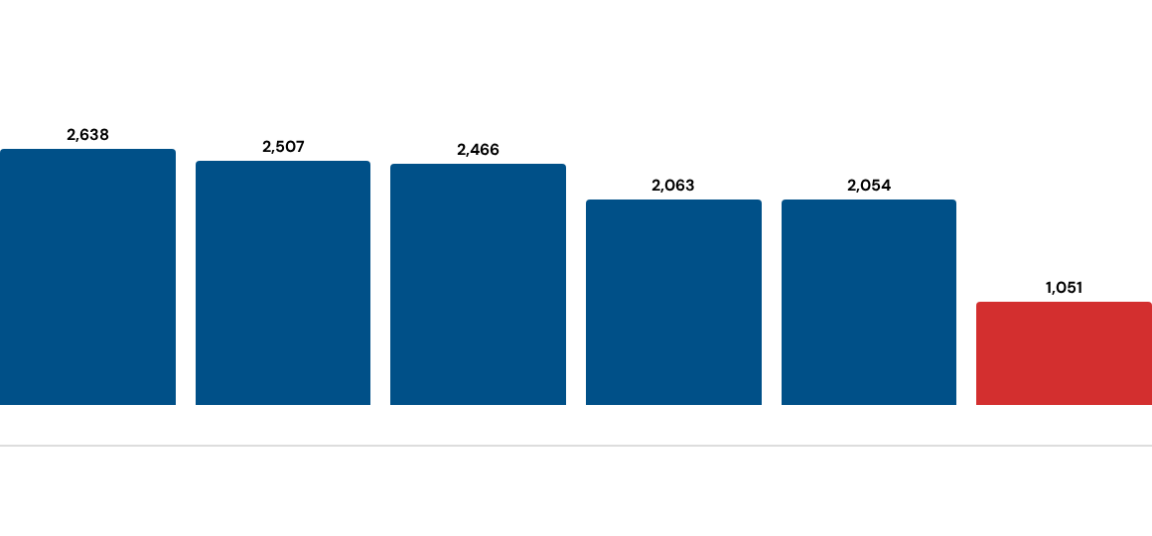
Exploratory Data Analysis: Labels
Distribution of Truthfulness
A balanced dataset is crucial for avoiding classifier bias towards majority classes.
*Data shows "Half-True" and "False" as dominant classes, with "Pants-on-Fire" being the most extreme and least frequent.

Slide 5
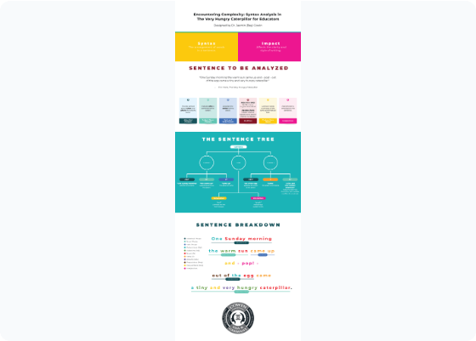
Linguistic Signature of Fake News
Key Stylistic Identifiers
Fake news often exhibits specific patterns that differentiate it from objective reporting:
•
Emotional Appeal: Higher usage of subjective and emotive language.
•
Complexity: Lower readability scores and less lexical diversity.
•
Sensationalism: Excessive use of punctuation (e.g., exclamation marks) and "clickbait" structures.
•
Uncertainty: Frequent use of hedging words or vague attributions.

Slide 6





Feature Engineering Strategy
Linguistic
Vectorization
Embeddings
Extraction of Readability scores (Flesch-Kincaid), Part-of-Speech (POS) tags, and Punctuation density.
Converting text to numerical data using TF-IDF (Term Frequency-Inverse Document Frequency).
Generating contextual representations using pre-trained BERT (Bidirectional Encoder Representations from Transformers).

Slide 7
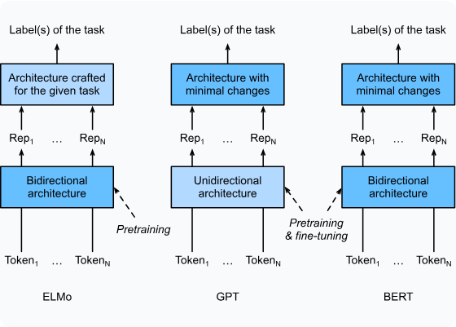
Modeling Approach & Classifiers
Ensemble of Methods
We compared shallow machine learning against deep contextual models:
•
Logistic Regression: A robust baseline for high-dimensional TF-IDF features.
•
Gradient Boosting: Capturing non-linear relationships in linguistic and metadata features.
•
BERT Transformer: Fine-tuned to capture semantic nuance and statement context.

Slide 8
The BERT Advantage
Bidirectional Context
Unlike traditional methods, BERT looks at the entire sequence of words at once, allowing it to understand the relationship between "not" and the rest of a political claim.
By leveraging pre-trained knowledge from vast corpora, it identifies subtle nuances in political rhetoric that correlate with misinformation, even in short-form text.

Slide 9
Comparative Performance Results
Model Architecture | Features Used | Accuracy (%) | F1-Score
Logistic Regression | TF-IDF + Metadata | ~65.2% | 0.64
Gradient Boosting | Linguistic + Metadata | ~68.4% | 0.67
Fine-tuned BERT | Embeddings + Context | ~72.8% | 0.71
*Performance on LIAR 6-way classification. Accuracy increases significantly (>85%) when collapsed to binary (Fake vs Real).

Slide 10

Cross-Domain Generalization
Generalizing Unseen Content
The true value of a fake news detector lies in its ability to handle new topics:
Insight
•
Health Domain: Performance drops slightly (~5-8%) when tested on medical misinformation.
Combining metadata with linguistic features provides the highest "Topic-Agnostic" performance for detection systems.
•
Thematic Stability: Models perform best when the political context (Speaker/Party) is known.
•
Linguistic Consistency: Stylistic features (emotion, complexity) generalize better than specific keywords.

Slide 11





Conclusion & Strategic Outlook
Key Finding
Criticality
Next Steps
Deep learning (BERT) significantly outperforms traditional ML by understanding contextual semantics in political discourse.
Linguistic signatures alone are insufficient; metadata (speaker history) is the strongest predictor in the LIAR dataset.
Integration of real-time knowledge graphs to verify claims against a dynamic "Ground Truth" database.

Slide 12

THANK YOU

